Slide 1
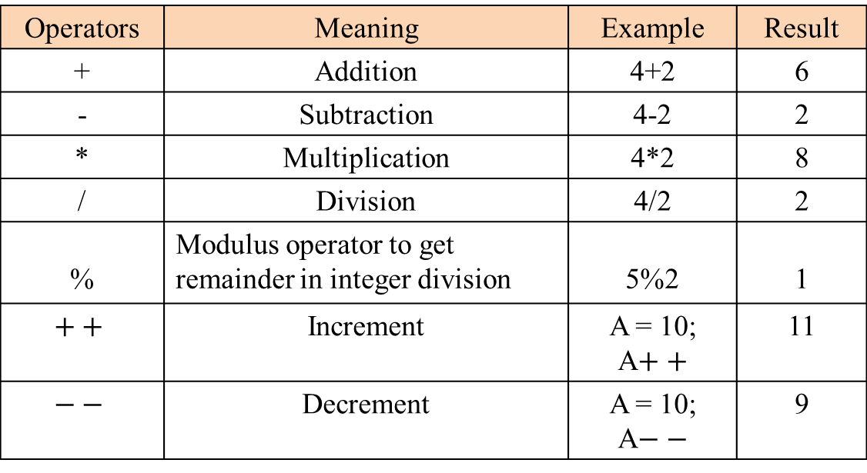
Arithmetic Operators
Operators | Meaning | Example | Result
+ | Addition | 4+2 | 6
- | Subtraction | 4-2 | 2
* | Multiplication | 4*2 | 8
/ | Division | 4/2 | 2
% | Modulus operator to get remainder in integer division | 5%2 | 1
$$++$$ | Increment | A = 10; A$++$ | 11
$$−−$$ | Decrement | A = 10; A$−−$ | 9

